Slide 1


Slide 2
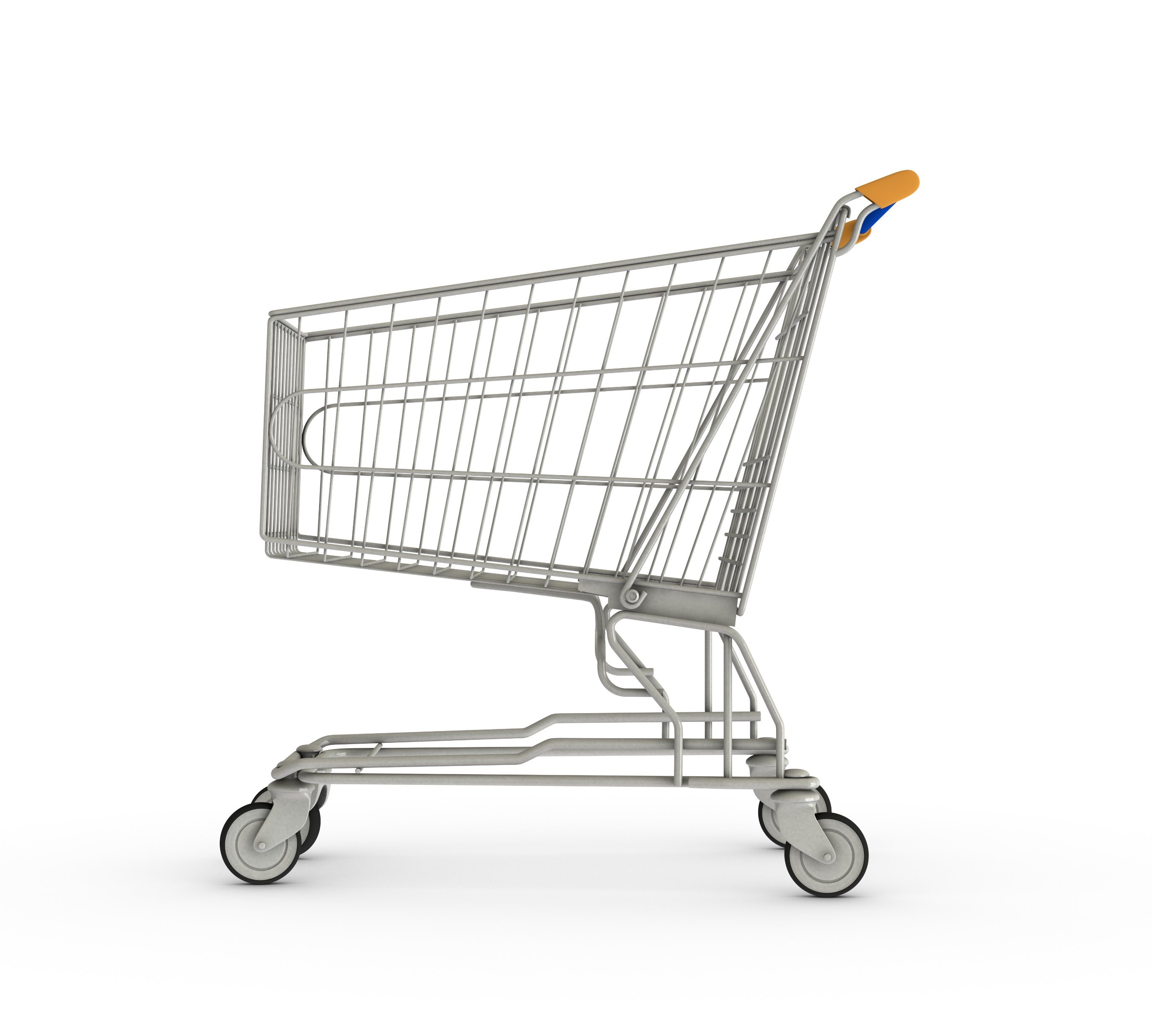



Domain
Function
Consumer Goods
Executive Management
Problem Statement
Consumer Goods Atliq Hardwares (imaginary company) is one of the leading computer hardware producers in India and well expanded in other countries too.
However, the management noticed that they do not get enough insights to make quick and smart data-informed decisions. They want to expand their data analytics team by adding several junior data analysts. Tony Sharma, their data analytics director wanted to hire someone who is good at both tech and soft skills. Hence, he decided to conduct a SQL challenge which will help him understand both the skills.
Task
Imagine yourself as the applicant for this role and perform the following task 1. Check ‘ad-hoc-requests.pdf’ - there are 10 ad hoc requests for which the business needs insights. 2. You need to run a SQL query to answer these requests. 3. The target audience of this dashboard is top-level management - hence you need to create a presentation to show the insights. 4. Be creative with your presentation, audio/video presentation will have more weightage.

Slide 3

Behind every great data set is a great company!
Get a quick peek about important aspects of our consumer goods company, Atliq Hardwares before we dive into the numbers

Slide 4

Atliq Hardwares have 74 customers who operates in 27 Different Countries (Markets)

Slide 5
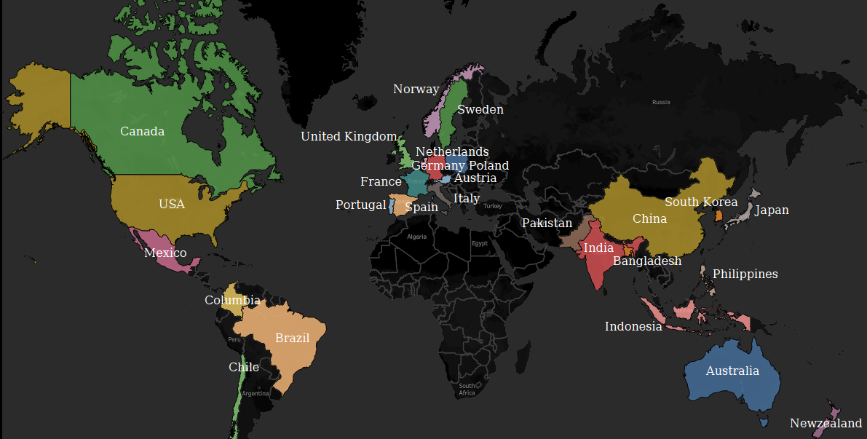
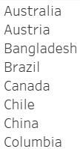
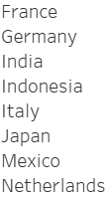
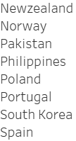
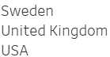
Different Markets

Slide 6



3 Distribution methods (Channels) are used to sell products :
Retailers refer to physical or online stores that sell products to consumers.
Direct sales refer to sales made directly to consumers through a company's website or other direct means
Distributors refer to intermediaries or middlemen between the manufacturer and retailer or end consumers.

Slide 7

Product Distribution
N & S
Networking
Wi fi extender
Storage
External Solid State Drives, USB Flash Drives
P & A
Accessories
Batteries, Keyboard, Mouse
Peripherals
Graphic Card, Internal HDD, MotherBoard, Processors
PC
Desktop
Business Laptop, Personal Desktop
Notebook
Business Laptop, Gaming Laptop, Personal Laptop

Slide 8
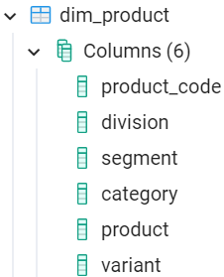
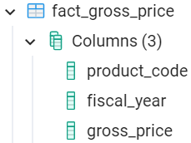
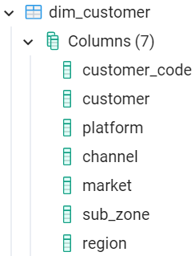
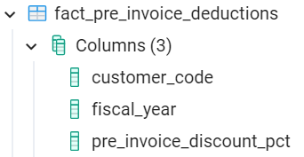
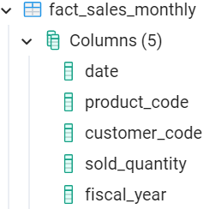
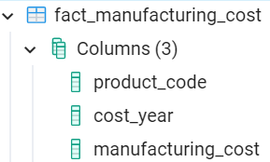
Database Structure

Slide 9

Are you curious to see what the data has to say?
Get ready for an exciting ride as we solve the ad hoc requests about our consumer goods company, Atliq Hardwares

Slide 10

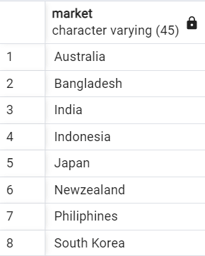
Request 1
Provide the list of markets in which customer "Atliq Exclusive" operates its business in the APAC region.
Output
Japan
India
Bangladesh
Indonesia
Australia
New Zealand

Slide 11
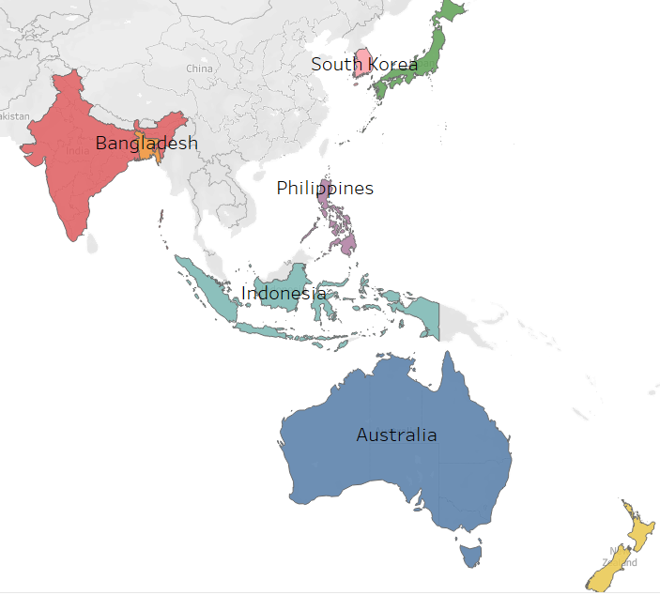
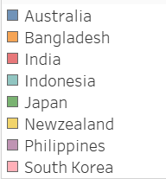

Visualization
Market
Japan
India
New Zealand
Insight
APAC region contains 10 markets. Out of those 10 markets, Atliq Exclusive operates on 8 markets, except - Pakistan and China.

Slide 12
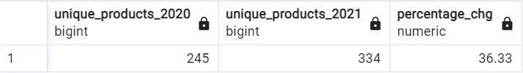
Request 2
What is the percentage of unique product increase in 2021 vs. 2020? The final output contains these fields, unique_products_2020 unique_products_2021
percentage_chg
Output
Japan
India
Bangladesh
Indonesia
Australia
New Zealand

Slide 13
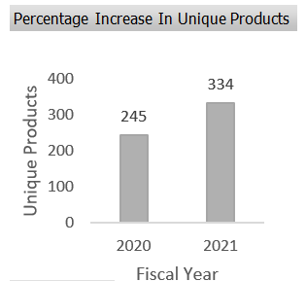
Visualization
Insight
A 36. 33 % jump in unique product in 2021 shows that Atliq Hardwares wants to offer a diversified range of products from which their customers can choose from.
+36.33%

Slide 14
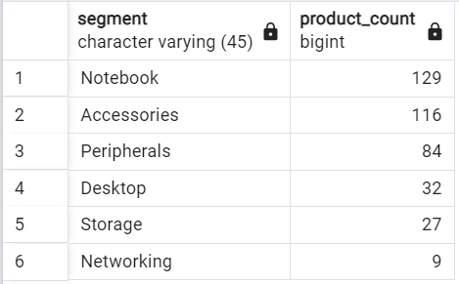
Request 3
Provide a report with all the unique product counts for each segment and sort them in descending order of product counts. The final output contains 2 fields, segment product_count
Output
Japan
India
Bangladesh
Indonesia
Australia
New Zealand

Slide 15
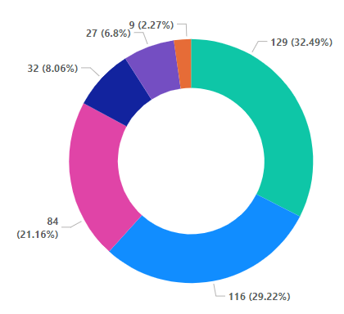

Visualization
Insight
Unique product count of Segments
1. Atliq Hardwares offers the most count of products in the “Notebook” followed by “Accessories” segment. It shows they have more focus on these areas.
2. “Peripherals” being the third suggests that company specializes producing components for computer assembly.
+36.33%
Note : Atliq Hardware should expand into areas with fewer products to address gaps in their product line and meet customer needs.

Slide 16
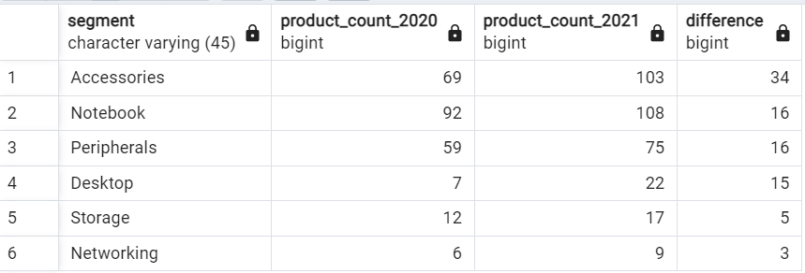
Request 4
Follow-up: Which segment had the most increase in unique products in 2021 vs 2020? The final output contains these fields, segment product_count_2020 product_count_2021 difference
Output
Japan
India
Bangladesh
Indonesia
Australia
New Zealand

Slide 17
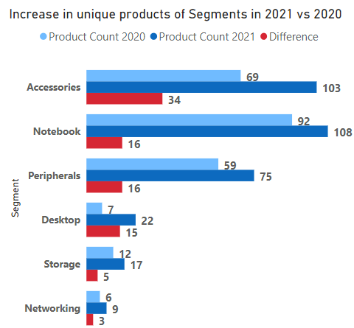
Visualization
Insight
1. All segments have a boost in product count in 2021
2. "Accessories" segment has the most growth. Pandemic might be reason, reflecting customers' interest in products that enhance their work-from-home setups, such as mouse, keyboards, and batteries.
3. “Notebook” and “Peripherals” has the 2nd highest increase, reflecting a demand for laptops for both personal and business use and computer components for cost-effective upgrades or DIY builds.
+36.33%

Slide 18
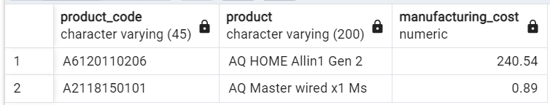
Request 5
Get the products that have the highest and lowest manufacturing costs. The final output should contain these fields, product_code product manufacturing_cost
Output
Japan
India
Bangladesh
Indonesia
Australia
New Zealand

Slide 19
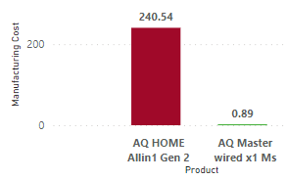
Visualization
Insight
Product with highest and lowest manufacturing cost
1. "AQ Master wired x1 Ms" has the lowest manufacturing cost of 1.
2. "AQ HOME Allin1 Gen 2“ has the highest manufacturing cost of 241 which was contributed due to high cost associated with its raw materials, labor, and overhead expenses.
Note : Atliq Hardwares should explore ways to reduce manufacturing costs to increase competitiveness by offering products at a lower price than competitors.

Slide 20
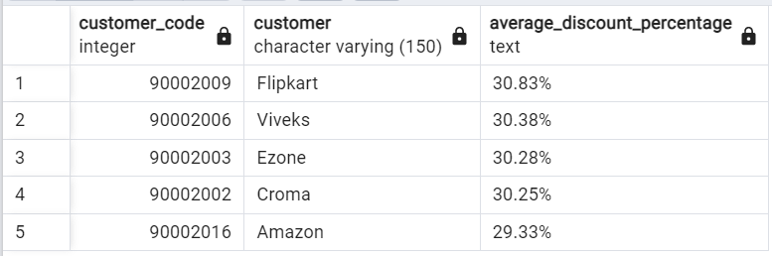
Request 6
Generate a report which contains the top 5 customers who received an average high pre_invoice_discount_pct for the fiscal year 2021 and in the Indian market. The final output contains these fields, customer_code customer average_discount_percentage
Output
Japan
India
Bangladesh
Indonesia
Australia
New Zealand

Slide 21
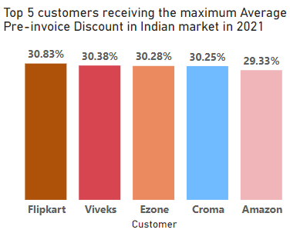
Visualization
Insight
1. Flipkart has the highest average discount percentage (30.83%) while Amazon has the lowest (29.33%).
2. Flipkart’s receiving the high pre-invoice discount on the products for its audience might be due to its:
Large order and long-term contract
Bargaining and Purchasing power
Offering lower commission margin
The high demand of its audience for hardware products.
Note : Atliq Hardwares should optimize pricing and discount strategies and negotiate more effectively with customers to maximize profitability and customer satisfaction.

Slide 22
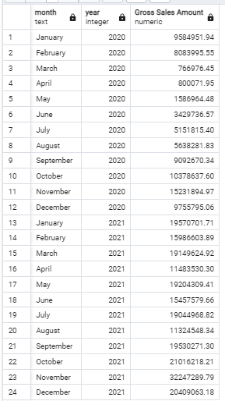
Request 7
Output
Get the complete report of the Gross sales amount for the customer “Atliq Exclusive” for each month. This analysis helps to get an idea of low and high-performing months and take strategic decisions. The final report contains these columns: Month Year Gross sales Amount
Japan
India
Bangladesh
Indonesia
Australia
New Zealand

Slide 23
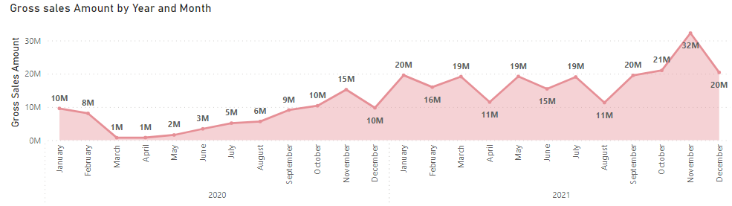
Visualization
Insight
1. November witnessed the highest gross sales in both 2020 and 2021 followed by September, October, and December likely due to seasonal factors and holiday shopping periods.
2. April performed the least suggesting a lack of major holidays or events driving sales during this period.
3. January performed well in both years possibly due to post-holiday demand and New Year's resolutions.
Note : 1) Atliq Hardwares can optimize sales revenue by targeting peak holiday periods and taking advantage of post-holiday demand.
2) They should also adjust their marketing strategies for lower-performing months like April to remain competitive.

Slide 24
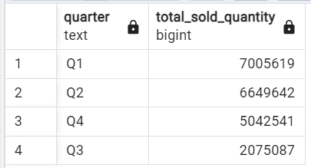
Request 8
In which quarter of 2020, got the maximum total_sold_quantity? The final output contains these fields sorted by the total_sold_quantity, Quarter total_sold_quantity
Output
Japan
India
Bangladesh
Indonesia
Australia
New Zealand

Slide 25
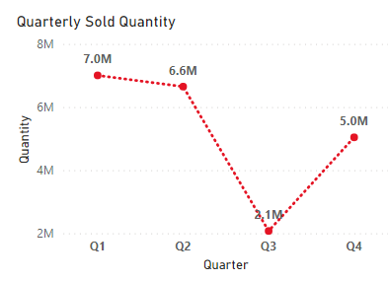
Visualization
Insight
Q1 – September 2019
October 2019
November 2019
Q2 – December 2019
January 2020
February 2020
Q3 – March 2020
April 2020
May 2020
Q4 – June 2020
July 2020
August 2020
1. The most profitable quarters are Q1 (7M quantity sold) and Q2 (6.6M). 2. Q3 has offered the least sale (2.1 M). One of the reason might be the pandemic.
Note : 1) Optimizing sales strategy during Q1 and Q2 is crucial for revenue maximization. 2) Investing in holiday-specific promotions and advertising to maximize revenue during Q4. 3) During uncertain times such as Q3 and the pandemic, the company needs to be flexible and explore new ways to sell their products and continue reaching customers.

Slide 26
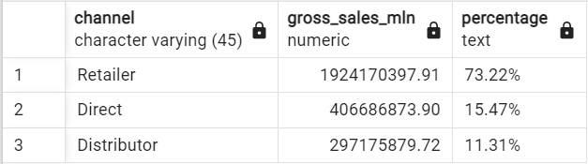
Request 9
Which channel helped to bring more gross sales in the fiscal year 2021 and the percentage of contribution? The final output contains these fields, channel gross_sales_mln percentage
Output
Japan
India
Bangladesh
Indonesia
Australia
New Zealand

Slide 27
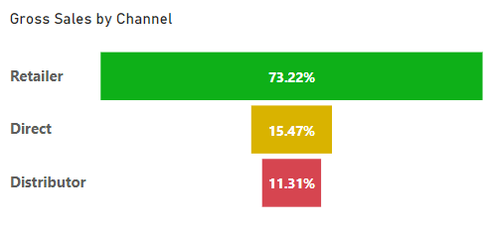
Visualization
Insight
1. 73% sales are coming through physical or online stores 2. 15% sales contributed directly from the company's website or other direct means. 3. 11% is from the intermediaries between the manufacturer and the end consumer.
Note : Atliq Hardwares should continue to invest in D2C that would help rely less on retail thereby assisting with larger sales margin.

Slide 28
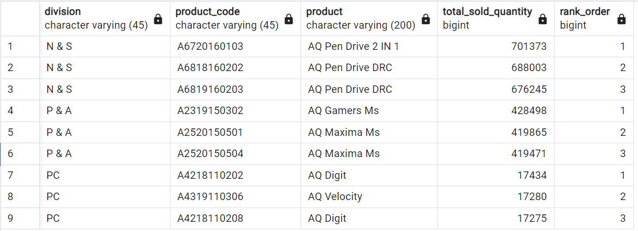
Request 10
Get the Top 3 products in each division that have a high total_sold_quantity in the fiscal_year 2021? The final output contains these fields, division product_code
product total_sold_quantity rank_order
Output
Japan
India
Bangladesh
Indonesia
Australia
New Zealand

Slide 29
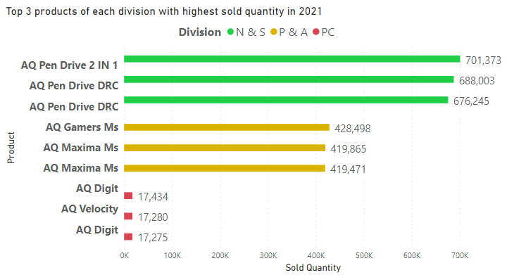
Visualization
Insight
1. In “N & S” division, USB Flash Drives products (“Accessories” segment) were sold in highest quantities in 2021. 2. For “P & A “ , Mouse products (“Storage” segment) were sold the most. 3. In “PC” division, Personal Laptops (“Notebook” segment) grabbed the limelight.

Slide 30

Thank you

